Slide 1
Medication Adherence Support System
Patient-Facing App Final Presentation
CS 6440: Introduction to Health Informatics - Fall 2016 - Georgia Tech
FHIR STOP is...
Arnab Barua (Narrator)
Adam Hachey
Mark Mullison (Narrator)
Dominick Roselli
Jiankun Sun
Notes:
Hi, I’m Mark Mullison with Team FHIR Stop. My team-mate Arnab Barua will be helping me walk you through our Final Project Presentation today.

Slide 2

Medication Adherence - What’s the Problem?
“Drugs don’t work in patients that don’t take them.” - Former US Surgeon General Dr. C. Everett Koop
Medication Adherence is the degree to which a patient adheres to a prescribed medication regimen.
In 2010, Non/Low-Adherence caused an estimated 125,000 deaths and cost US$290 billion*
*The 21st Century Intelligent Pharmacy Project: The Importance of Medication Adherence, 2010, Center for Health Transformation, page 1.
Notes:
This semester, we’ve been working on the Medication Adherence problem.
People not taking their meds as prescribed costs lives and money. It causes medical complications and even death. It also drives up health care costs in a number of ways including increasing the number of
Hospitalizations and nursing home admissions.

Slide 3
Costs of Low/Non-Adherence
Annual Cost in 2010: $290 billion
Other stats:
125,000 Americans die annually from low medication adherence
Ten to 25% of hospital and nursing home admissions result from poor compliance
Up to 40% of patients don’t adhere to their treatment regimes
Up to 20% of new prescriptions go unfilled.
Rates of non-adherence have been stagnant over the past three decades
Adapted from The 21st Century Intelligent Pharmacy Project: The Importance of Medication Adherence, 2010,
Center for Health Transformation, page 1.
Notes:
Here are the stats. You saw the $290 Billion Dollar annual cost and 125,000 deaths every year on the last page…we were surprised when we saw the problem’s impact. The fact that the adherence rates haven’t changed over the last three decades was really surprising and made us ask: what are we doing about this?

Slide 4
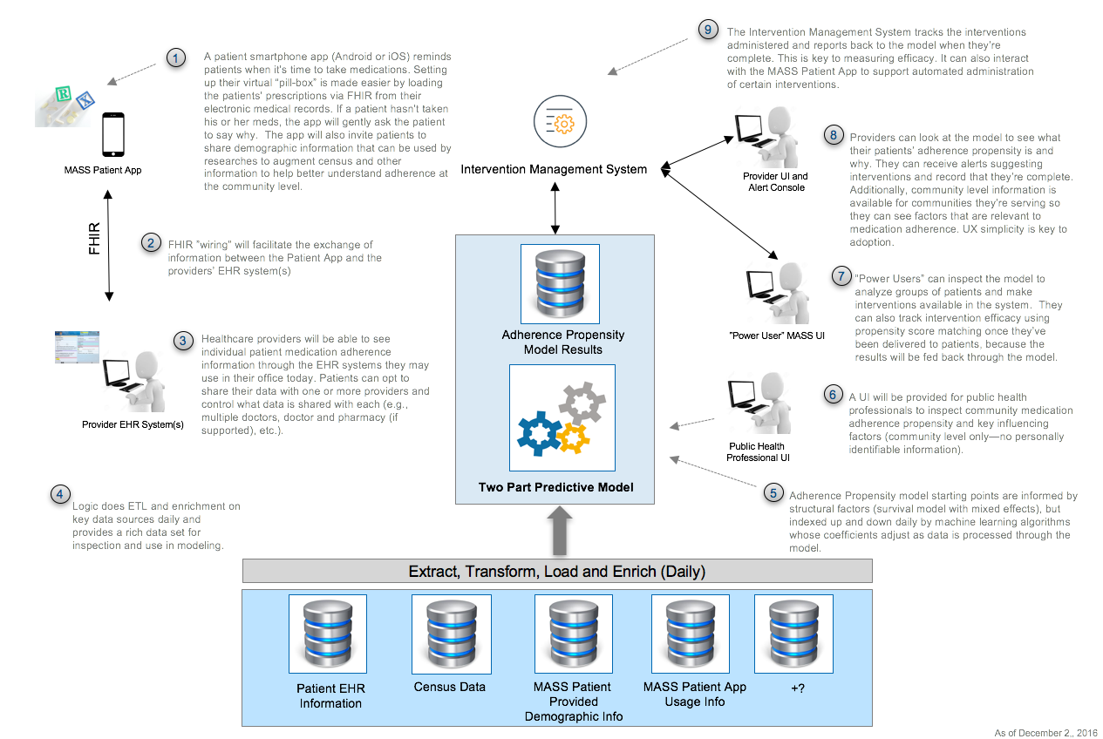
Medication Adherence Support System (MASS): Conceptual Architecture
Notes:
It's is a big, multi-part problem… and there’s lots of value in solving it.
So some folks from the Centers for Disease Control wrote a project proposal to help do that. We took their proposal as our challenge and developed the conceptual architecture you see here.
There’s a lot on this page, so if you’d like to spend a little more time with it, just press the pause button.
[ CUT Let me briefly walk you through it. The solution has five main components:
First, there’s a mobile app for patients. (That’s #1 on the diagram)
Next, there’s wiring that gets data to and from the provider's EMR system (that's number 2)
Third, there’s a “big-data” and analytics component that’s used to model adherence (that's numbers 4, and 5 on the diagram)
Fourth, we’ve got a few custom User Interfaces: there’s one for Public Health Professionals (that’s component #6).
There's also a custom Healthcare Provider UI which augments the provider's existing EMR system, and a Power User UI to do more advanced things with the system. (that's numbers 7 and 8 on the diagram).
And finally, there's an “intervention management system” that tracks and in some cases administers interventions (that's number 9) END CUT]
It’s a big vision, with a lot of potential. But it's way more work than we had time for this semester. So we focused our work on building a POC of the Patient Facing App (that's #1 and #2 in the diagram). Even though we knew we couldn’t work on all of this, we wanted to invest the time in developing a complete conceptual architecture for two reasons: First, we wanted to be able to put our work into context, and second we thought there'd be value to future classes in being able to more quickly frame up a semester’s worth of work. Our work to focus this semester's efforts would have gone much faster had we had the reference architecture shown here, so we hope it's useful to future classes. Our mentor, Skip Clelland, at the CDC has told us that he plans to use this to inform future development projects; so we’re happy with that. It represents a significant amount of thinking. We used it to create a list of potential future projects, and that list is in our GitHub repo.

Slide 5
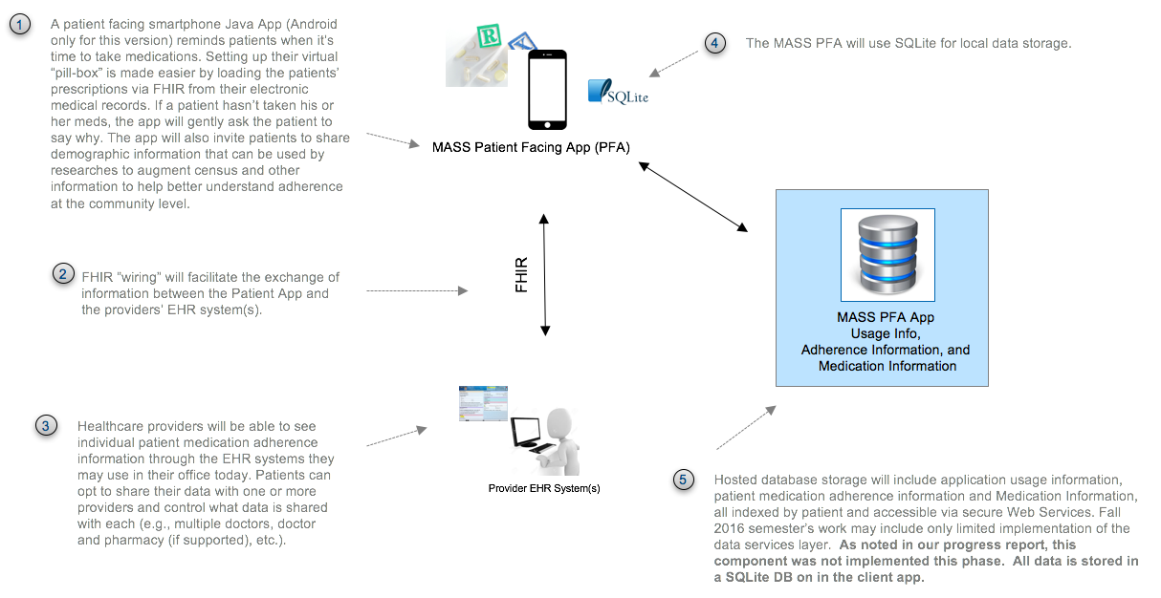
MASS Patient Facing App - Architectural Overview
Notes:
So again, our focus this semester was the patient facing app. Here’s what the architecture for that component looks like.
This app is a patients’ virtual “pill-box.” There are lots of apps available now that do that, but this one gets prescriptions from the patient’s EHR via FHIR and it also captures patient demographic behavioral information. That’s important because it’s envisioned that census data and other health care record information will be used to understand aspects of medication adherence. Asking patients to include relevant demographic information will augment that data filling in potential holes, and hopefully lead to more meaningful insights.

Slide 6
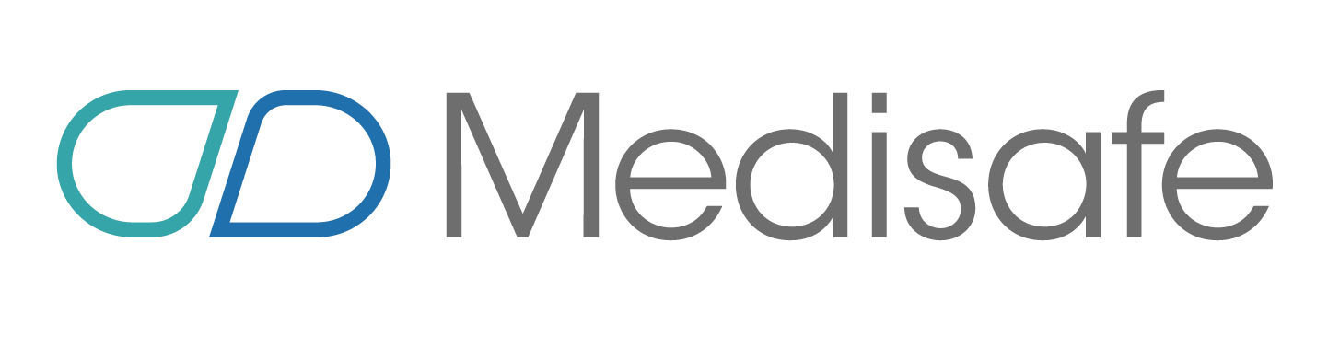


What research did we do?
Medication adherence background
Current apps in the market
Interviews with CDC staff regarding usage (some recordings available in GitHub as .MP3s)
Medical Adherence Apps: http://blog.evisit.com/top-apps-improve-medication-adherence
Notes:
We did a good bit of research on the medication adherence problem in general. And once we knew we’d be focusing on the patient facing app, we also looked at what virtual pill-box/medication minder apps were available and checked those out. And lastly, we interviewed staff at the CDC to provide expert user advice and input. Our mentor Skip Clelland was very helpful as was Renee Robinson and several others at the CDC.

Slide 7
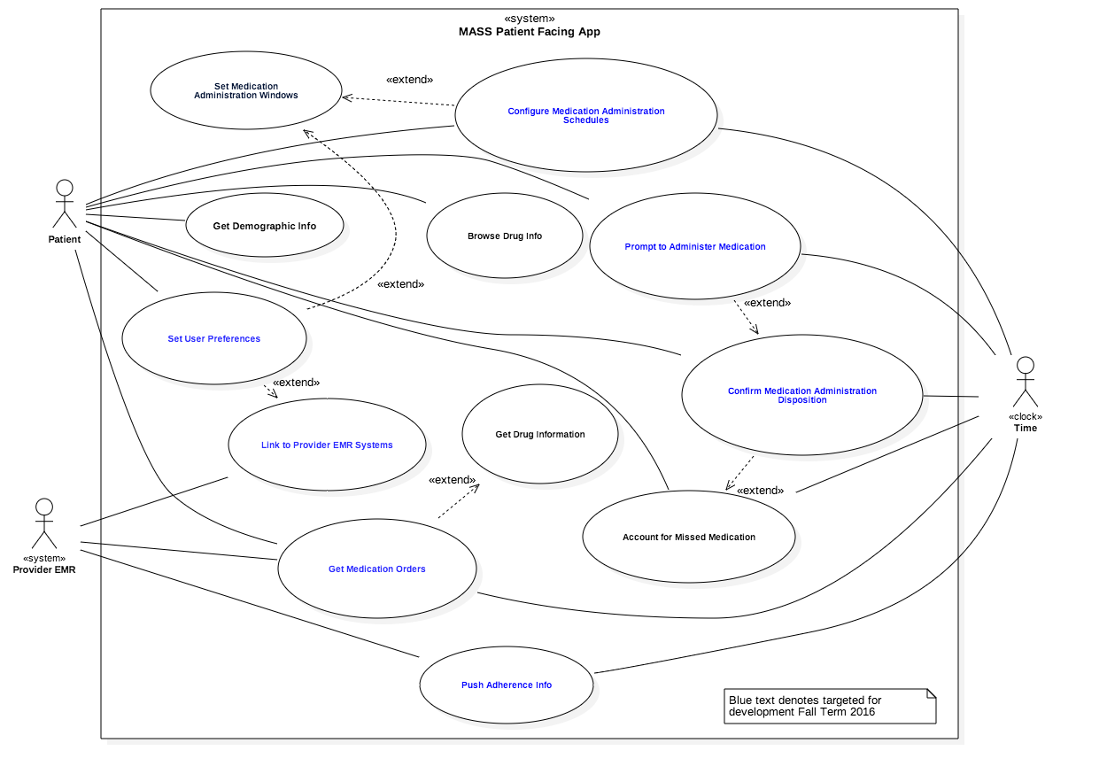
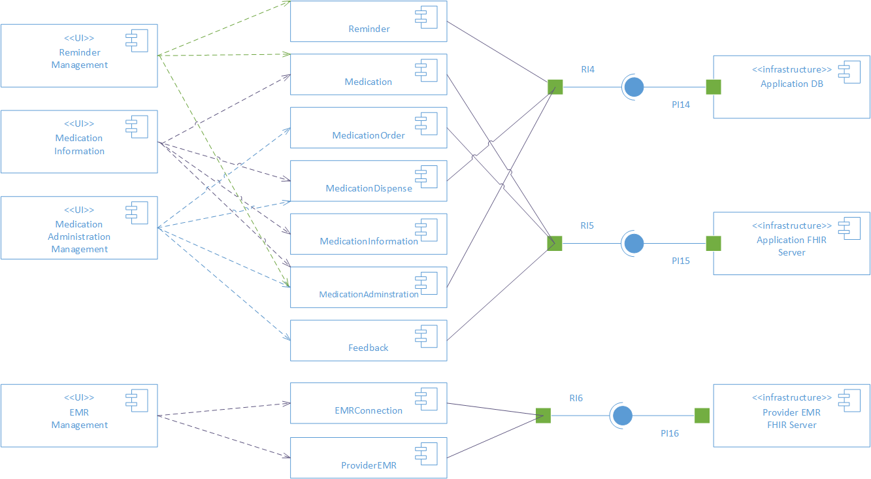
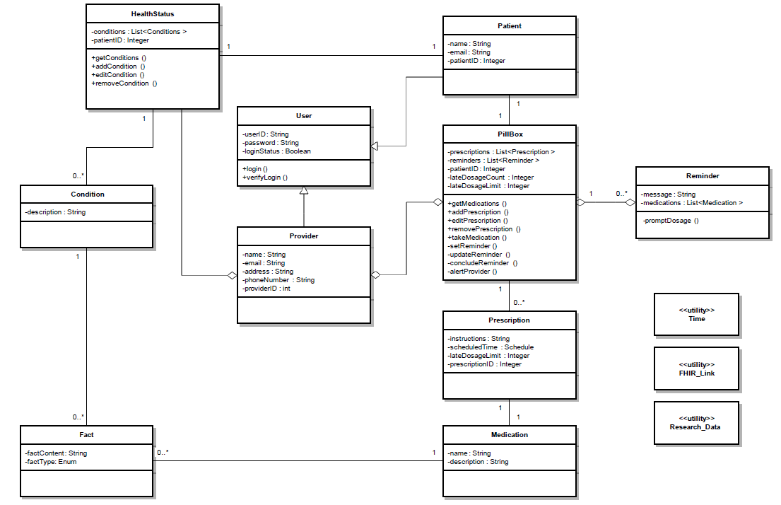
Design
Use Case Model
Component Diagram
Conceptual Architecture
Class Diagram
All artifacts available in our GitHub repo at: https://github.gatech.edu/gt-hit-fall2016/Improving-Medication-Adherence
Notes:
Here are some of the artifacts that came out of our investment in design. You saw the conceptual architecture on the right earlier. In addition to that, we’ve produced a pretty good Use Case Model, Class Diagram, and Component Diagram.
We’re proud of the design work we’ve done.
Okay, so you know we focused on building a patient facing app that would get a patient's medication orders via FHIR, let people setup schedules for when to take their meds, and track whether they took them and if not, why not, so that researchers could understand more about medication adherence. Rather than spend any more time looking at slides, let’s go ahead and show you our demo. For that, I’ll hand it over to my team-mate Arnab Barua. Over to you Arnab.

Slide 8
(Demo - Live Screen Cap with Voice Over)
Notes:
Thanks Mark. Let me give you a tour of our app.
One of the things you heard Mark say that makes our app different than the other pill-minders on the market is that you’re able to pull medication orders via FHIR from a provider’s EMR system. Here you see that we can configure a server connection.
Once you've got a connection configured, it pulls the medication orders…the idea is that this happens once a day or on demand. We’re using our old friend Marla Dixon. [show that]
Then we can configure a schedule for medication orders
Configure a Schedule for a Med Order
Show a reminder
Answer that you took the med – this is important because we track this information and store it for later.
Show pushing back to FHIR server (simulated provider EMR) – This use case was still in progress when we ran out of time. Base classes are there, but I can’t demo it for you.
Collect Demographic Information
There's a quick tour. Back to you Mark.

Slide 9
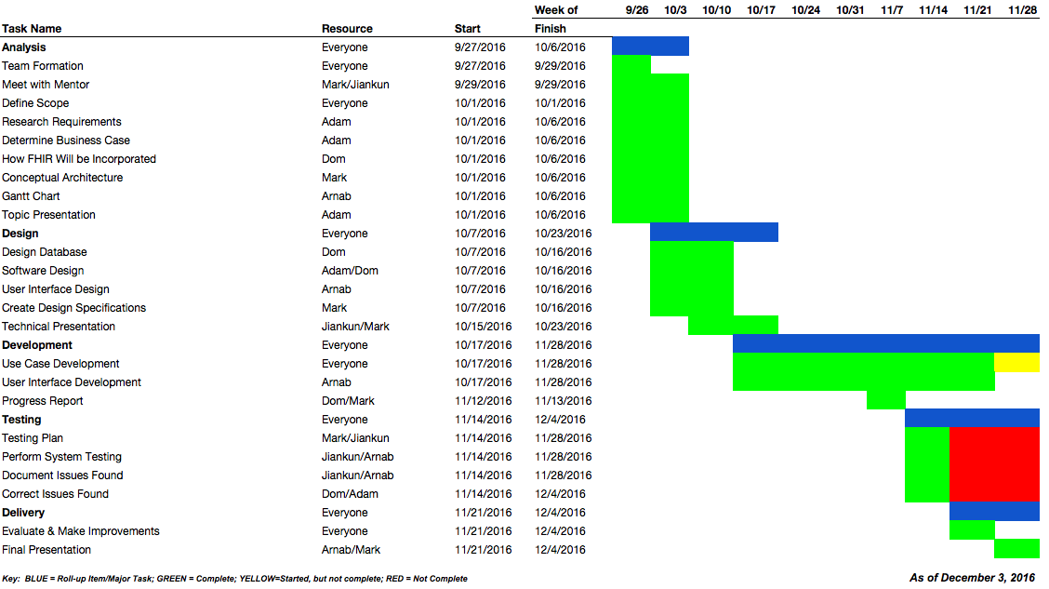
Notes:
Thanks Arnab.
Here’s our project plan, updated with latest status as of the end of the project. You’ll notice lots of green…we’ve made a lot of progress. We didn't go through a formal testing cycle. That’s because we didn’t go as quickly with development as we had hoped we would and we prioritized use case implementation over formal testing.
We think we’ve made good progress. As noted in all of our previous presentations, there was risk in the plan given the unkowns, and we’ve had to adapt as we went along based on how quickly we were working through issues.

Slide 10
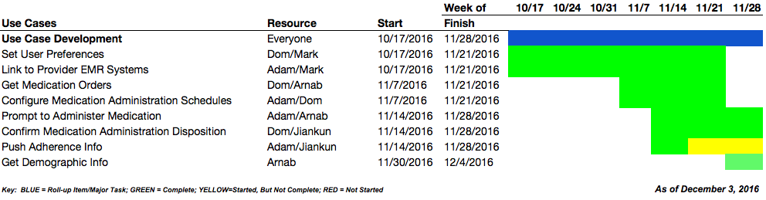
Notes:
Here’s our final version of the Use Case Detail breakout schedule. As you can see, we’re not done with the Push Adherence Info yet, but we’ve finished everything else we set out to do based on our last update.

Slide 11
What’s new with our work/Where did we innovate?
Sync prescriptions and administration information with provider EMR systems via FHIR
Gather demographic information about the patients
App asks users why they didn’t take their meds (if they didn’t) and gathers that information
The Medication Adherence Support System offers a comprehensive solution framework that not only will help solve the problem, but allows for efficacy measurement of any number of initiatives through propensity score matching
Notes:
Lot of pillbox apps, but not ones that maintain sync with provider EMR’s via FHIR.
They also don’t gather demographic information of the patients for analysis later in understanding medication adherence at the community level and they don’t ask why a patient didn’t take his or her meds.
And lastly, there is no comprehensive solution framework like what we’ve proposed in the Medication Adherence Support System. Which is admittedly “pie-in-the-sky” but it’s doable and pretty exciting.

Slide 12
Summary: So how did it all end?
This semester we…
…had a big, ambiguous problem that we worked through and put together a framework that provides a context for our work and future projects.
…were Android Newbies and struggled with the tech but got traction in the end and produced some good work that can be built on by future class teams.
…built a very good proof of concept that links to a FHIR server, gets medication orders, let’s users schedule when they want to take their meds and reminds them when it’s time. It also captures whether they took the med
…learned a ton about some Android development, FHIR, and the Medication Adherence problem.
Notes:
In summary, we started with a huge scope with no actionable requirements, we focused on one area and worked with our mentors to refine the ideas and use cases. We had very little experience with Android app development starting out and that made it slow going for a while as we got up to speed. But we’ve built a good proof of concept and taken the first step in organizing future work to help realize the vision.

Slide 13
What’s next for this project?
Stage is set for future iterations to turn our “proof-of-concept” into a shippable product.
Framework is available for at least a dozen really interesting future projects.
And of course… we’re looking forward to checking out some of the great work that our classmates did this semester and enjoying the holiday season!
Notes:
Regarding the patient facing app, we think with one more semester's work, it could be shippable and could start being used in some community in beta. But even more interesting than that, as we mentioned, we put together potential a list of how building out the Medication Adherence Support System might be chunked up to fit within the CS6440 class framework--that would be fun to watch evolve.

Slide 14

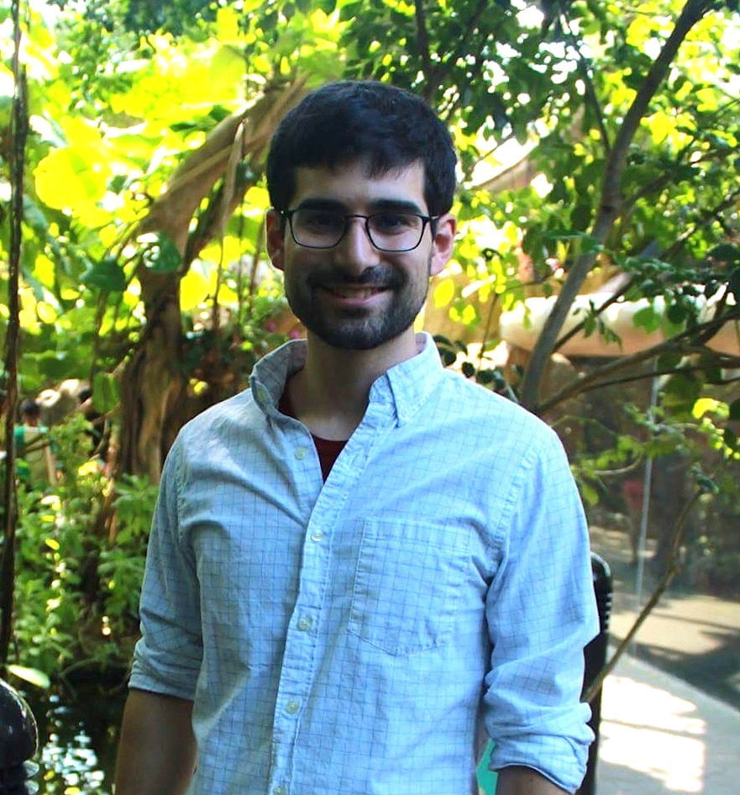
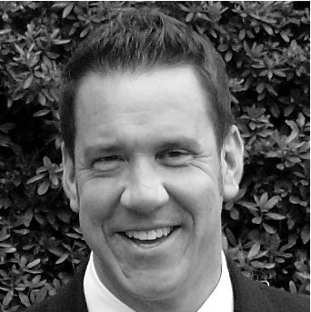
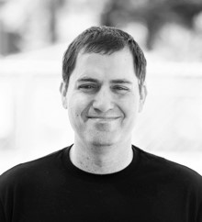
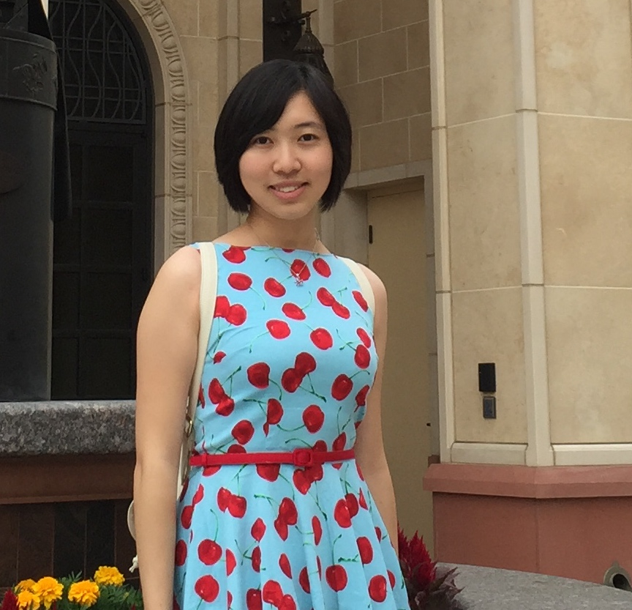

Thanks for checking out our work! (And don’t forget to take your meds if you’re supposed to!)
Team FHIR Stop – Fall Term 2016
Arnab Barua
Adam Hachey
Mark Mullison
Dom Roselli
Jiankun Sun
Notes:
It's been a great semester. We've learned a lot. Special thank you to our CDC mentor Skip Cleelland and our TA, Tia Pope, and of course to Dr. Braunstein for putting together a great class. That's all we had to share. Thanks for listening.

